Slide 1
Before You Begin
Introduction to Unix for HPC
Raijin version

Slide 2
General Introduction
Intersect http://www.intersect.org.au/
Who we are?
Your Trainer
Your University IT Contacts
General Housekeeping
Toilets
Coffee & Water Facilities
Emergency Exits
Slide 2
Notes:
2

Slide 3
Course Information
Who is the course intended for?
What will be covered: Shell, Data, HPC
What level will you be at upon completion of the course?
Remember – It’s YOUR course, so ask questions!
Slide 3
Notes:
3
Who is this course for?
This is a two day general introductory course for researchers and PhD students who have never used high performance computing before or have had only limited exposure. It assumes only basic Windows competence (W.I.M.P.), and will teach participants how to interact via the command line, move data between different locations and prepare and run it through the HPC facilities. It will be delivered in a small group workshop including presentations and hands-on exercises with tutors.
Shell competence
• how to connect to the Intersect HPC facility by connecting/establishing a session in a command line environment using a Linux shell
• the basics of using Putty and Secure Shell (SSH) to log in to the HPC machine
• the basics of how a shell works (commands, arguments)
• how to navigate and create a directory hierarchy using Bourne Again Shell (BASH) commands
• how to inspect and summarise the contents of files using BASH commands
• how to save the output of commands, and how to link commands together
Data Handling for HPC usage
• how to transfer data to and from the HPC machine.
• how to perform in-situ editing of files on the HPC machine
• how to change permissions on files and folders on the HPC machine for individual users and groups
• how to install and configure an FTP program
• how to navigate around local and remote folders.
• how to transfer files between local and remote folders.
• different file types: text, binary, DOS, Unix.
• using Putty Secure Copy (PSCP) for bulk transfers on the command line.
• how to get a dataset off the web and onto the server.
Using the HPC to run jobs
• manage jobs on the HPC machine using Portable Batch System (PBS)
• understand the disk partitions, properties and when to use them
• write job scripts
• submit and delete jobs
• understand some PBS environment variables
• understand machine limits

Slide 4
Download training materials
Training Material available from:
http://www.intersect.org.au/course-resources
Download the Slides and save to a local directory.
Slide 4
Notes:
4

Slide 5
Install software
If you use Windows: use your web browser to download Putty and PuttySCP from:
http://www.putty.org
Download Filezilla from the web for Windows and Mac.
https://filezilla-project.org
Slide 5
Notes:
5
Explain about SSH & Telnet, and explain what the Putty client is used for

Slide 6
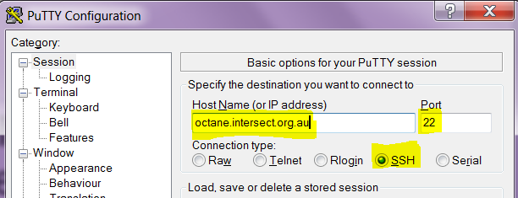
Logging On
Start the putty telnet/ssh client by double clicking on putty.exe and connect to the HPC Machine
Host: raijin.nci.org.au
Connection Type: ssh
Port: 22
raijin.nci.org.au
Slide 6
Notes:
[Instructions to the instructor are in brackets and bold]
Users may be presented with a security warning for the first time they connect from their machine (accept ssh key). They should click OK to accept.
6

Slide 7
Log On to Raijin
If you use a Mac use the terminal program:
ssh iaa444@raijin.nci.org.au
If you use Windows use putty. into Raijin
Account Name: iaa444 – ibx444
iaa, iab, iac… iax, iba, ibb, ibc …ibx
Password: provided by your instructor
Slide 7
Notes:
[Instructions to the instructor are in brackets and bold]
7

Slide 8
Shell Primer
Introduction to Unix for HPC

Slide 9
Unit 1: Run Spot, Run
Goals:
Can run commands, including when there are spaces in arguments
Can use ‘man’ to find out more about commands, including arguments and parameters
Slide 9

Slide 10
What is a Shell?
The shell is a command line interpreter or shell that provides an interface to the UNIX operating system.
A shell has a single purpose – to allow users to enter commands to execute, or create scripts containing commands, to direct the operation of the computer
Slide 10
Notes:
A computer runs programs/commands. That’s what it’s for.
A shell is a program that allows users to ask the computer to run other programs.
On a windows system, the philosophy is that commands are big things, and you run them once to do your work. They are easy to use, but not very flexible.
On a Linux/Unix system, the philosophy is that commands are small things that do one small thing. They are hard to use, but very flexible.
BASH is the shell that we use, and is more or less the de-facto standard shell for Linux.
Everything you do on the HPC system involves either telling a shell to run commands, or getting ready to tell a shell to run commands.
When you first log in to an HPC system, you will be presented with the command prompt.
You have already run commands before – for example when you installed this module.
10

Slide 11
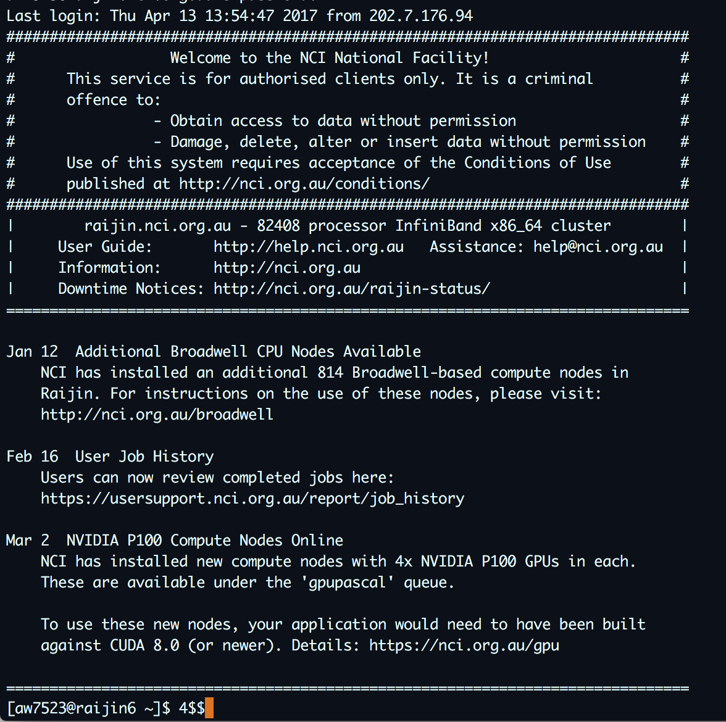
Slide 11
Notes:
This is a picture of what shells look like for me.
[Point out]
the shell runs inside a window called a ‘terminal’
the shell has a prompt that is waiting for your input
The prompt can vary – I use it to keep track of where I am (more on this later)
11

Slide 12
More on UNIX Shells
This course uses BASH
BASH = the Bourne-Again Shell
Default shell for most Linux systems
Other common Shells include:
C Shell (csh)
K Shell (ksh)
TENEX C Shell (tcsh)
Slide 12

Slide 13
Anatomy of a command
Commands comprise of:
a command that invokes a program
arguments to that program
[user4@raijin ~]$ cmd arg1 arg2 arg3
[user4@raijin ~]$ cmd arg1 arg2 arg3 “arg 4”
command prompt
command
Arguments (3)
username
Machine
(login node)
command
Arguments (4)
Slide 13
Notes:
Each time you enter something on the command line and hit return, BASH will do something.
Almost every time, it will run the command specified by the first word on the command line, and pass it the arguments specified by the rest of the words on the command line.
Discuss use of white space in arguments
13

Slide 14
Commands and Shells
Commands allow users to interact with the operating system via the shell
Two-way communication is possible between the shell and commands
e.g. the ls command will return a list of files in a directory
Slide 14
Notes:
14

Slide 15

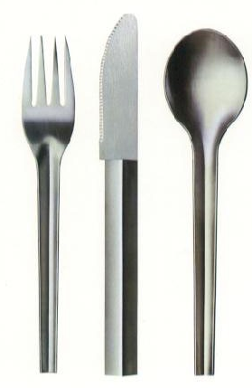
Slide 15
Notes:
Explain the difference between using a program (e.g. powerpoint) which has a huge set of commands in-built
versus
Running individual commands which all together can be very powerful
15

Slide 16
Exercise 1(a)
Try these commands
Command | Description
ls | Shows a directory listing
w | Shows who is logged on to the system and what they are doing
w iaa444 | Shows login, idle time, and what user iaa444 is doing
finger | Shows login, username & login details of users on the system
finger iaa444 | Shows user iaa444’s login details including name, idle time, login time as well as some of their environment settings
date | Prints the system time and date
uptime | Tells you how long the system has been running
Slide 16

Slide 17
Command Line Options (Flags)
Command Line Options / Flags modify the operation of the command.
There are two forms of flags – Short Form & Long Form.
Flags are case sensitive!
Short form options start with a single hyphen “-”
rm –f <filename> → force removal of file
Long form Options start with a double hyphen “--”
rm –-force <filename> → force removal of file
Both commands do the exact same thing!
Slide 17

Slide 18
Sample Command & Flags
ls –a
short form flag “-a”
Shows all files incl. files starting with .
Slide 18
Notes:
There are also conventions – the community of Linux developers got together and said “let’s do it like this.” Like all conventions, there are plenty to choose from.
18

Slide 19
More Commands & Flags
ls –l
short form flag “-l”
Shows the long format listing for all files in the directory
Slide 19
Notes:
There are also conventions – the community of Linux developers got together and said “let’s do it like this.” Like all conventions, there are plenty to choose from.
19

Slide 20
Combining Flags
Flags can be combined in any order but still mean the same thing
The following command and flags all show the directory contents and show one file per line:
ls –a -l
ls –l -a
ls –la
ls –al
ls –-all –l
ls –l -all
Slide 20

Slide 21
Command Line Arguments
Command Line Parameters are arguments sent to the program being called.
Parameters are case sensitive!
Short form options start with a single hyphen “-”
tail –n 20 <filename> → tail from the last 20 lines of the file
Slide 21

Slide 22
Exercise 1(b)
Try these Flags and Parameters
Command | Description
ls | Shows a directory listing
ls -l | (long) Lists directory contents of current directory using long listing format
ls –a ls --all | (all) Lists directory contents of current directory and does not ignore entries starting with .
ls –la ls –all –a | (all+long) Lists directory contents of current directory using long listing format and does not ignore entries starting with .
ls –format=horizontal | Lists directory contents of current directory horizontally
ls -–format=single-column | Lists directory contents of current directory in a single column
Slide 22
Notes:
22

Slide 23
Using the “man” pages
All Unix systems come equipped with manual or “man” pages which contain documentation about how each in-built command works
Man pages can be accessed using the following command format:
man program, e.g. man ls
To quit a man command, press q.
Slide 23

Slide 24
Exercise 1(c)
Print a calendar from Feb-Apr 1964.
Command | Description
man <command name> | Print the online manual entry for <command name>
cal | Print a calendar
Slide 24

Slide 25
Unit 2: Where am I?
Goals:
Can explore navigate a hierarchy of directories
Can specify files with relative and absolute paths
Can create a hierarchy of directories
Can copy and move files between directories
Slide 25
Notes:
25

Slide 26
UNIX Directories
Called ‘folders’ under windows
Exactly the same concept
You run into them a LOT more under Unix than you do under windows
A directory is a container
It can contain files and other directories
Slide 26
Notes:
The concept of a working directory is there in every program, but you often don’t realise it under windows.
Directories are the de-facto way of managing and organising data in Linux. Making your HPC life easy will in a large part depend on keeping files and directories clean. Many of you have already learned this lesson on windows. This module is intended to give you to tools to do the same thing.
26

Slide 27
/
ac3
What are the names of the contents of the directory called “/” (root folder)?
bin
etc
home
usr
/ac3
/bin
/etc
/home
/usr
Slide 27
Notes:
A directory is a container for files and other directories. There’s lots of ways to visualise it, but a common one is as a tree view. Another is as a graph of boxes, with arrows representing directories. And yet another is as stacked boxes one within another.
One of the things that a directory can contain is other directories.
[Introduce the notation – closed and open directories.]
Question 1: What is the contents of the directory called “/”
Answer: ac3, bin, etc, home, usr
[Here is where we bring up absolute and relative paths.]
[Make note of case sensitivity.]
27

Slide 28
/
ac3
What are the names of the contents of the directory called /home?
bin
etc
home
hpc01
/home/hpc01
/home/hpc02
/home/hpc03
/home/hpc21
hpc02
hpc03
hpc21
usr
Slide 28
Notes:
Opening the home directory, we can see the contents (there will be more in real life).
[Introduce the notion of a PATH.]
28

Slide 29
/
ac3
What are the names of the contents of the directory called /home/hpc02?
bin
etc
home
hpc01
/home/hpc02/regurgitator.sh
hpc02
regurgitator.sh
hpc03
hpc21
What are the names of the contents of the directory called /home/hpc21?
regurgitator.sh
usr
/home/hpc21/regurgitator.sh
Slide 29
Notes:
You can also put files into a directory.
Every file on your computer has a unique name (it starts with a /, and tells you exactly where the file lives).
Note that files can have the same name, as long as they are in different directories.
29

Slide 30
Rules So Far
There is one root, called “/”
This is different from windows, where there is one root for each disk drive C:, D:, etc
A path from the root designates exactly one file: such a path is called an “absolute path”
Slide 30
Notes:
[Make note of C: D: vs just /….]
30

Slide 31
The Home Directory
Each account (user) has a special directory called his/her home directory
That’s where you ‘get put’ when you log in. (More on this later)
BASH uses the “~” character to indicate “home directory”
Two forms
~ “my home directory”
~iaa444 “iaa444’s home directory”
Slide 31
Notes:
31

Slide 32
Rules So Far
There is one root, called “/”
A path starting with “/” means “from the root”
A path starting with “~” means “from the home”
Slide 32
Notes:
32

Slide 33
Change dir and list content
Command | Description
cd | Change the working directory to your home directory
cd <path> | Change directory to <path>
ls | List the contents of the working directory
ls <path> | List the contents of <path>
Slide 33

Slide 34
The Working Directory
BASH maintains a “working” or “current” directory. That is “the directory that you are currently in”
Your prompt will show you your current working directory
Linux uses the “.” character to denote the working directory. You can use this when running commands
ls –la . → show the listing for the current dir
The command “pwd” will list the current working directory
Slide 34
Notes:
Make note of C: D: vs just /….
34

Slide 35
Looking upwards
UNIX uses “..” to denote the parent of a directory. You can use this when running commands, e.g.
cd .. → change up 1 directory
cd ../hpc01 → change up 1 directory, then down 1 directory to hpc01
UNIX understands “..” as a “normal directory” and it can appear in a path
Slide 35

Slide 36
~
What is the relative path of
../experiment two/step one/file one
experiments
experiment one
description
What is the working directory?
step one
file one
file two
step two
file one
experiment two
description
step one
file one
file two
step two
file one
Slide 36
Notes:
[Keep asking the question and click three times.]
- what is the answer to “what is inside ‘file one?”
- it depends on the answer to “what directory am I in?”
[Here is where we bring up absolute and relative paths.]
[Make note of case sensitivity. ]
36

Slide 37
Everything about directories
There is one root, called “/”
A path starting with “/” means “from the root”
A path starting with “~” means “from the home”
A path starting with anything else means “from the working directory”
Slide 37
Notes:
37

Slide 38
Finding your way around
Command | Description
pwd | Print the name of the current working directory
cd .. | Change directory to the parent directory
ls | List the contents of the working directory
ls . | List the contents of the working directory
ls .. | List the contents of the parent directory
Slide 38

Slide 39
Making New Directories
You can create a directory, but only one at a time (by default)
mkdir </path/new_directory>
mkdir </path/to/new/directory>
Slide 39
Notes:
The path/to/new/directory has a very special property: path, path/to and path/to/new all have to exist, but path/to/new/directory must not exist.
[***JOE: FIX THIS***]
39

Slide 40
What happens when you execute the commands?
~
experiments
experiment one
mkdir ~/experiments
cd ~/experiments
mkdir “experiment one”
mkdir “experiment one/step one”
mkdir “experiment one/step two”
mkdir “experiment two”
cd “experiment two”
mkdir “step one”
mkdir “step two”
step one
step two
experiment two
step one
step two
Slide 40
Notes:
40

Slide 41
Exercise 2(a)
Create the tree
Command | Description
mkdir <path> | Make a directory at <path>
pwd | Print the name of the current working directory
cd <path> | Change directory to <path>
ls <path> | List the contents of <path>
~
experiments
experiment one
step one
step two
experiment two
step one
step two
Slide 41

Slide 42
Moving/Copying Files Around
Files live in exactly one location
Files can be copied and moved between directories
cp <from path/file> <to path/file>
mv <from path/file> <to path/file>
Slide 42

Slide 43
~
What happens when you execute the commands?
experiments
experiment one
description
step one
cp “experiment one/description” “experiment two”
file one
cd “experiment one”
file two
step two
cp “step one/file one” “../experiment two/step two”
file one
cp “../experiment two/description” ../other
experiment two
cd “../experiment two/step one”
description
step one
mv “file one” “../step two”
file one
file two
step two
file one
other
Slide 43
Notes:
43

Slide 44
Exercise 2(b)
Moving and Copying Files
Command | Description
cp <from> <to> | Copy a file from <from> to <to>
mv <from> <to> | Copy a file from <from> to <to> then remove <from>
man cp man mv | Print the online manual entry for <command name>. What happens when you provide more than two arguments to cp and mv?
Slide 44

Slide 45
Unit 3: It’s what’s inside that counts
Goals:
Can look inside files (even really big ones)
Can obtain rudimentary information about files
Slide 45
Notes:
45

Slide 46
Looking into files
Command | Description
ls | You’ve met before
cat <filename> | Print a file to the terminal (catenate)
less <filename> | Like cat, but less at a time
head <filename> | Like cat, but just the top of the file
tail <filename> | Like cat, but just the end of the file
wc <filename> | Word count – count the words in a file
du | Disk usage – how much space is used
Slide 46
Notes:
46

Slide 47
Unit 4: It’s all just files
Goals:
Can save the output of programs into files
Can chain commands together
Slide 47
Notes:
[Make note about the philosophy again – smaller number of concepts – this time console and keyboard are just files. Flexible, but confusing.]
47

Slide 48
OUTPUT
The program
INPUT
ERRORS
Slide 48
Notes:
Can write to other places if it wants to, but every Linux program has access to STDIN, STDOUT and STDERR
48

Slide 49

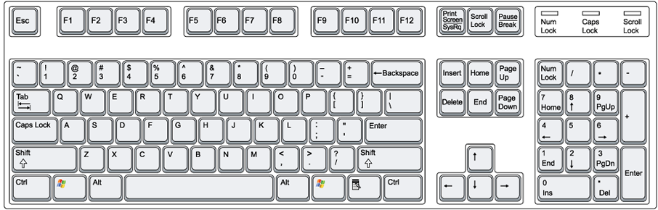
OUTPUT
The program
INPUT
ERRORS
command
Slide 49
Notes:
49

Slide 50

Redirect OUTPUT elsewhere…
>
OUTPUT
The program
INPUT
ERRORS
command > filename
Slide 50
Notes:
50

Slide 51
Append OUTPUT elsewhere…
>>
OUTPUT
The program
INPUT
ERRORS
command >> filename
Slide 51
Notes:
Won’t overwrite the file, but rather append.
[Mention < as well.]
51

Slide 52
Pipe OUTPUT to a command…
|
Another program
OUTPUT
INPUT
The program
OUTPUT
INPUT
ERRORS
ERRORS
command | another_command
Slide 52
Notes:
This is the glue that allows lots of little programs to work together.
52

Slide 53
Exercise 4(a)
Create a file and try the commands below
Command | Description
sort <file> | Sorts the contents of <file>, or input if no file is specified.
uniq <file> | Removes any redundant lines in <file>, or input if no file is specified. Redundant lines have to be adjacent to be considered redundant.
cat <file> | Prints the contents of <file>
<command> > <file> | Run <command> but rather than print the output to the console, redirect the output to <file>.
<command> >> <file> | Run <command> but rather than print the output to the console, append the output to <file>.
<command> | <command> | Pipe one <command> to another <command>
Slide 53
Notes:
53

Slide 54
Unit 5: Products of our environment
Goals:
Can set and read environment variables
Can add programs to the PATH
Can query the environment for which variables exist
Slide 54
Notes:
54

Slide 55
PATH
There is a ‘special’ thing called the PATH
Part of what makes it special is encoded
Part of what makes it special is convention
There is an environment full of variables
One of those variables is called PATH
Use ‘$’ to tell BASH you’re talking about a variable
To check what an environment variable is set to, use $<ENVIRONMENT_VARIABLE>
e.g. $PATH
Slide 55
Notes:
The encoded aspect in there are variables, and the operating system will manage them for you.
The convention part is that one of the variables is called PATH, and that is where most things (e.g. shells like BASH) will look for programs to run.
55

Slide 56
A sample path
/bin:/usr/bin:/usr/local/bin:.
Slide 56
Notes:
Search order. First one found wins.
56

Slide 57
What does BASH do?
When you hit return
BASH parses the command line into tokens
Any ‘special’ tokens are expanded
The first token is treated as the command
The remaining tokens are passed to the command as arguments
Slide 57
Notes:
[Recall from very early in the module.]
57

Slide 58
A simple example
Your home directory is stored in the environment, you can be taken there directly
cd $HOME
Slide 58

Slide 59
Exercise 5(a)
Realistic Evaluation of the Environment
Command | Description
$<VARIABLE> | Evaluates to the contents of the variable <VARIABLE>.
env | Prints all environment variables and their values.
echo <arg1> <arg2> … | Prints out its arguments, with no additional information.
grep <pattern> <file> | Prints out all occurrences of <pattern> in <file>. If no file is specified, processes standard input. For example env | grep PA will print all variables containing ‘PA’ in them or their value.
Slide 59
Notes:
59

Slide 60
Manipulating the Environment
You can use the environment to your advantage.
Update the path
Change your prompt
Use the environment to share information between your scripts
Slide 60

Slide 61
Manipulating your environment
Command | Description
export <VAR>=<VAL> | Set a variable called VAR and give it contents VAL. The variable will be available to programs invoked from the shell.
Slide 61
Notes:
61

Slide 62
Summing up – Your Skills
You have now got the rudimentary skills to move around, make and view files, chain commands together and manipulate the environment
Slide 62

Slide 63
Summing up – Hard Lessons
BASH is wildly picky
Silent success
Command-line work is flexible but error prone
There’s a lot of hidden context
ENVIRONMENT, WORKING DIRECTORY, STDOUT/STDIN, COMMAND LINE EXPANSION
Slide 63

Slide 64
Summing up – the positives
Command line gives you a more powerful means to control a program
Allows direct interaction with shell commands (no GUI needed)
Allow for ease of automation via scripting
UNIX is more flexible and can be installed on many different types of machines (e.g. mainframes/supercomputers)
Slide 64

